Slide 1
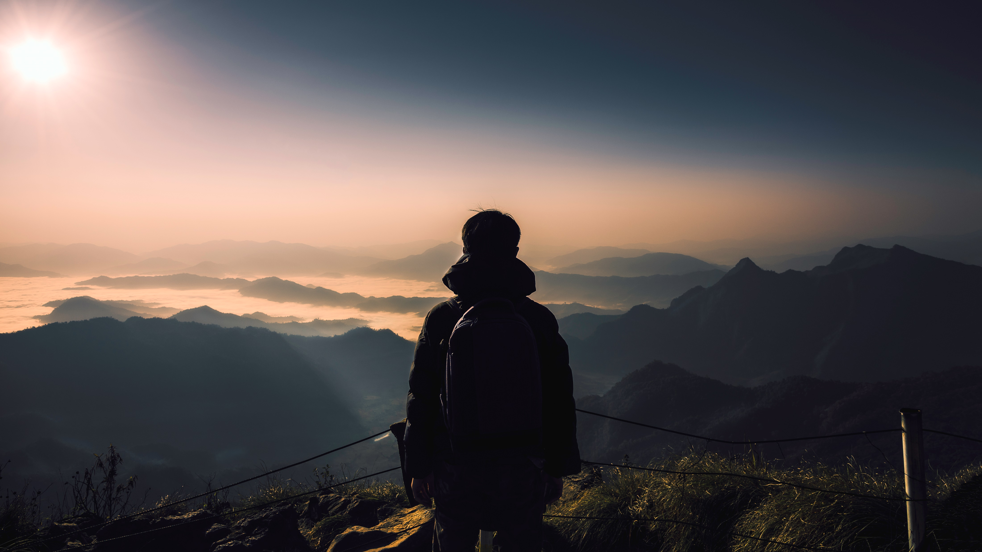
AUTONOMOUS TRANSPORT

Slide 2
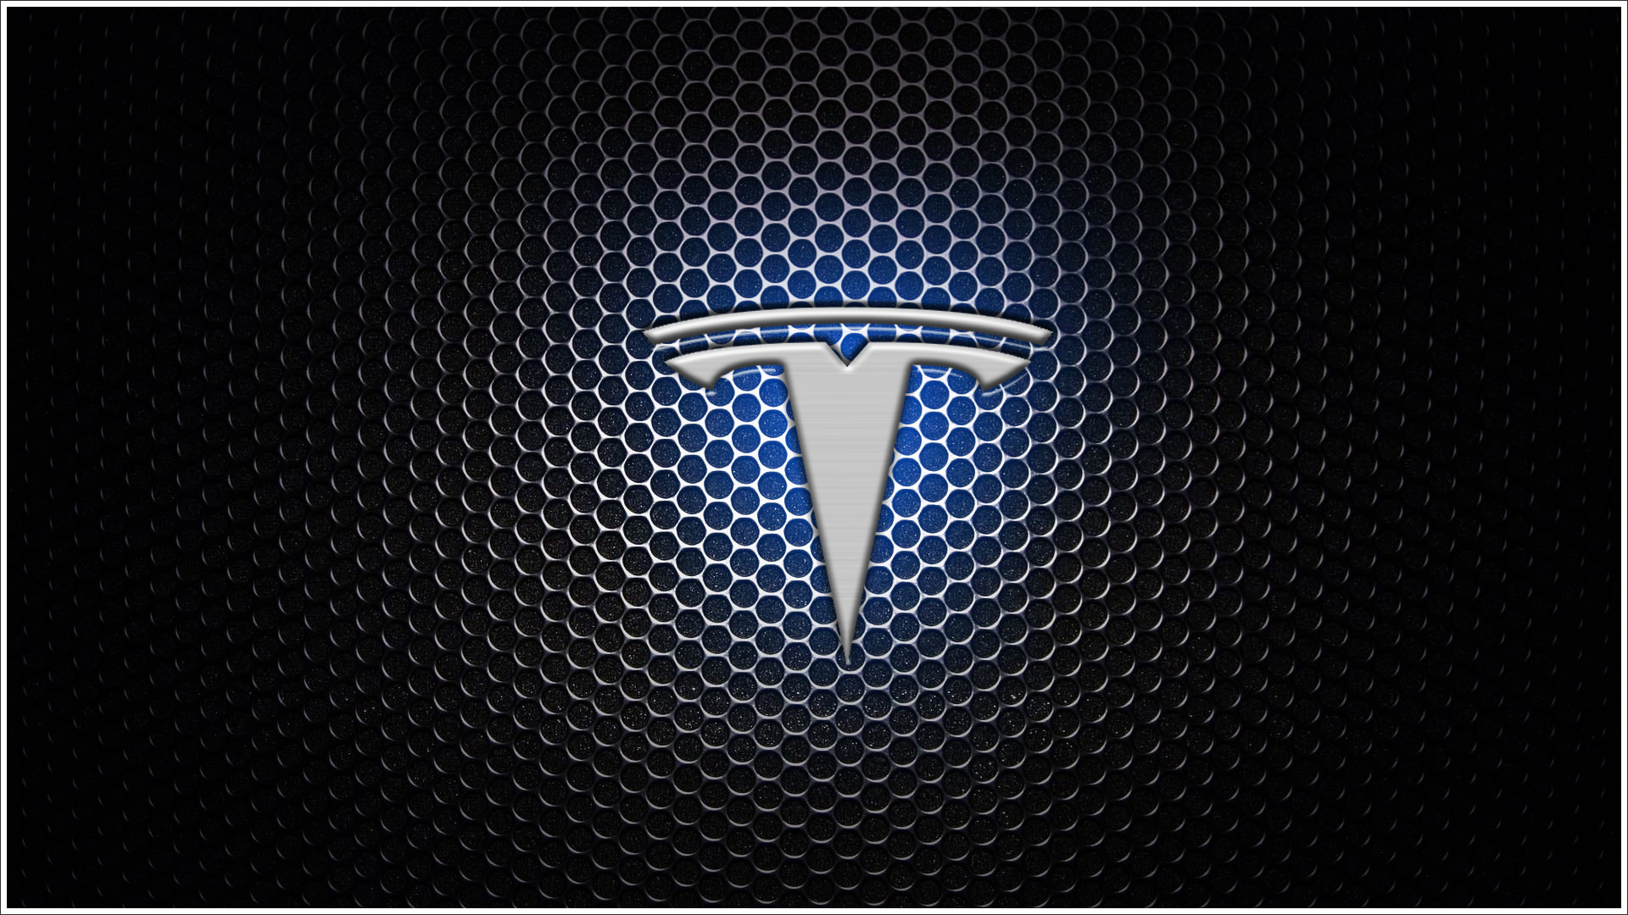
Objective: Integration into existing infrastructure
We all have a dream Car right! So on the go my dream car is Tesla but what I found recently is that Telsa too has flaws. Tesla is already leading in EV technology and self-driving, but there’s always room for innovation. Here are some key areas Tesla can improve and introduce new features to enhance safety, performance, and user experience.

Slide 3
FEAUTURES OF tesla
Tesla Autopilot is Tesla's advanced driver-assistance system (ADAS) that enables the car to steer, accelerate, and brake automatically under driver supervision. It’s constantly improving through AI, neural networks, and real-world data collection.
Traffic aware cruise control: Maintains speed and distance from other vehicles
Autosteer: keeps the car centered in its lane on highways
Auto Lane change: changes lanes automatically when safe
Auto Park: parallel and perpendicular parking assistance
Smart summon: Brings the car to you from a parking lot
Traffic light and stop sign control: identifies and responds to traffic signals

Slide 4
FLAWS IDENTIFIED
Cannot recognize hand signals in case of traffic signal failure.
Incapable of detecting emergency vehicles.
High E-waste generation.

Slide 5

Guess what!? We can now recognize hand signals incase of signal failure. Let’s know how.

Slide 6
1. Data Collection
Collect a dataset of hand signals relevant to Tesla’s operations (e.g., stop, turn left, turn right, speed up, slow down).
Capture images or video frames from different angles, lighting conditions, and distances.
Annotate the dataset with labels corresponding to the hand signals.
2. Preprocessing
Convert images to grayscale or use color normalization.
Resize images to a fixed dimension (e.g., 224x224 for CNNs).
Apply data augmentation (rotation, flipping, brightness adjustments) to improve generalization.
3. Model Selection
Use Convolutional Neural Networks (CNNs) for image-based recognition (e.g., MobileNet, ResNet, or custom CNNs).
Alternatively, use Transformers (e.g., Vision Transformers - ViT) for improved accuracy.
If real-time video processing is needed, use Recurrent Neural Networks (RNNs) or LSTMs with CNN features.

Slide 7
4. Training the Model
Use a framework like TensorFlow/Keras or PyTorch.
Train on a dataset using a classification loss function like categorical cross-entropy.
Validate the model using test data to ensure accuracy and avoid overfitting.
python
Use transfer learning (e.g., fine-tuning pre-trained models) to speed up training.
5. Real-time Deployment on Tesla
Convert the model to TensorFlow Lite (TFLite) or ONNX for edge deployment.
Integrate with Tesla’s computer vision stack (Autopilot/FSD).
Use OpenCV to capture real-time images from Tesla's cameras and preprocess them.
python
6. Integration with Tesla's System
Tesla’s Full Self-Driving (FSD) and Autopilot system uses neural networks.
If using Tesla’s API, hand signal recognition can be integrated as an additional input.
The recognized signal should trigger appropriate actions (e.g., stopping if a "stop" hand signal is detected).

Slide 8
7. Testing & Optimization
Test in real-world conditions to check for false positives/negatives.
Optimize model performance for low latency.
Ensure robustness against varying environments (rain, night, occlusions)

Slide 9
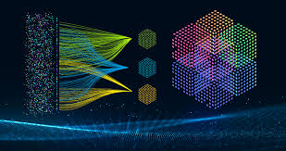
Technologies used:
Neural network training for hand signals
V2X(Vehicles to everything) communication
IOT
Self learning and deep learning
Pattern recognition

Slide 10
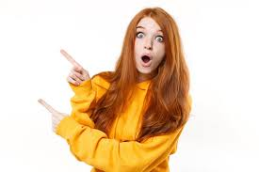
Let’s use RRR! Not a blockbuster film but a environment booster fetch

Slide 11
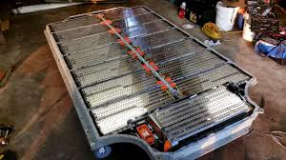
EV batteries recycling process:
Using closed loop battery recycling program to collect batteries from customers after its use is exhausted.
Discharging and mishandling
Shredding and material separation
Chemical processing
Reusing in new batteries

Slide 12
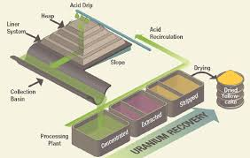
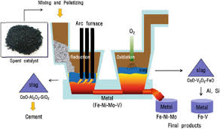
Technologies used:
Pyrometallurgical (Smelting)
Hydrometallurgical (Leaching)
Direct Recycling

Slide 13
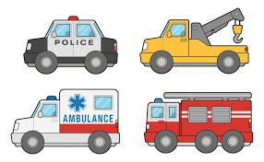
Introducing the seventh sense just like motherly instincts

Slide 14
Tesla detects emergency vehicles using a combination of computer vision, audio processing, and sensor fusion within its Autopilot and Full Self-Driving (FSD) system. Here’s how it works:
1). Camera-Based Detection (Computer Vision)
Emergency vehicle lights (flashing red, blue, or white lights).
Vehicle shape recognition (police cars, ambulances, fire trucks).
Text or symbols on vehicles (e.g., "POLICE" or "FIRE").
2). Audio-Based Detection (Microphones & AI)
Tesla vehicles listen for sirens using built-in microphones.
AI models process these sounds in real time, distinguishing them from background noise.
If a siren is detected, the system alerts the driver and can adjust driving behavior (e.g., slow down, yield, or pull over).

Slide 15
3). Sensor Fusion (Radar & Ultrasonic Sensors)
Older Tesla used radar to detect large vehicles in fog, rain, or night conditions.
Tesla Vision (camera-only approach) now replaces radar, relying on deep learning for emergency vehicle recognition.
Ultrasonic sensors help detect close-proximity emergency vehicles, especially in low-speed conditions.
4). Tesla Autopilot Response to Emergency Vehicles
Once an emergency vehicle is detected, Tesla's system can: ✔ Alert the driver via visual/audio notifications. ✔ Slow down or stop if sirens/lights are nearby. ✔ Move aside (if required and possible). ✔ Yield at intersections when emergency vehicles are approaching. ✔ Modify navigation routes if a road is blocked by an emergency response.

Slide 16
Technologies used:
Artificial Intelligence and machine learning
Supervised learning, unsupervised learning
Reinforcement

Slide 17
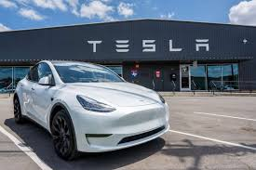

Not only these but Tesla can also be used as a source of income

Slide 18
Introducing Robotaxi:
This is an automation system where a robot will do things for you
One can use it as a taxi to travel for daily purposes or can enjoy a hassle free long drive
Why Robotaxi when you can Uber?
Available 24/7
No Human driver required
Less expensive
No emissions
No waiting
Passive income

Slide 19
Implementation:
Predicting passenger behaviour
Smooth parking and entry, exit for riders
Improve decision making by training ai
By sharing real time data
Robotaxi should drive autonomously to tesla super charges

Slide 20
Technologies Used:
Artificial Intelligence
Deep learning
Machine learning

Slide 21
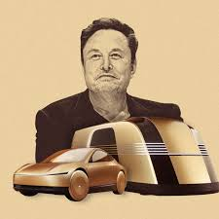

Slide 22
Thank You

